Slide 1
Presentation at The Kazakhstan Ministerial Conference Globalization and University Ranking
Sing Kai Lo, PhD(UC Berkeley)
Associate Vice President (Internationalization)
The Education University of Hong Kong

Slide 2
University Rankings I
Different rating systems
systems are using different methods
even methods for data collection are not the same, for example
some systems gather information on publicly available data
some systems ask individual institutions to provide their own data

Slide 3
University Rankings II
Different sub-systems within a system
overall ranking
ranking on subjects / disciplinary areas
ranking on (social) impact … etc
who are you competing with (young uni)
consider what is best for your institution

Slide 4
The Education University of Hong Kong
QS University Ranking 2023
4th in Asia
21st in the world
in Education*
*EdUHK consistently among top rank in Education

Slide 5
Top University by Education
in the World
University College London
Harvard University
Stanford University
University of Cambridge
University of Oxford
University of California, Berkeley
University of Toronto …

Slide 6
Ranking and Globalization: Relationship
Internationalization is a key domain in almost all ranking systems
Common View: Internationalization improves university ranking
seems implying a one directional relationship
but, higher ranking helps to attract more international students
also helps to attract more international visiting scholars and research collaborations
2-way traffic; they complement each other

Slide 7
The Education University of Hong Kong
Student Recruitment
Master of Education (number of applicants)
2009 (no ranking): ~300 to 400
2023 : ~2,300
Doctoral Programs
2009 (no PhD program) : ~80
2023 (3 doctoral programs) : ~900

Slide 8
World’s Top 2% Most-Cited Scientists *Extract from the EdUHK ’s biannual newsletter, Education-plus (Dec 2022) (n=34)
Scholar | Category | Scholar | Category
Dr Vonika Au Ka-man | Organic Chemistry | Professor Ho Wing-kei | Physical Chemistry
Professor Chetwyn Chan Che-hin | Rehabilitation | Professor Liz Jackson | Education
Dr Chen Junjun | Education | Professor Jim Chi-yung | Ecology
Dr Eddie Cheng Wai-lun | Building & Construction | Professor Kong Siu-cheung | Education
Professor Cheng Sheung-tak | Gerontology | Professor John Lee Chi Kin | Education
Professor Cheng Yin-cheong | Education | Dr Li Wai-chin | Environmental Sciences
Professor Cheung Yan-leung | Finance | Professor Li Wai-keung | Statistics & Probability
Professor Chiu Ming Ming | Education | Professor Lim Cher Ping | Education
Professor Chou Kee-lee | Gerontology | Dr Lo Chung-kwan | Education
Dr Jesus Alfonso D. Datu | Social Psychology | Professor Lo Sing-kai | General & Internal Medicine
Professor John Nguyet Erni | Literary Studies | Dr William Lo Yat-wai | Education
Dr Lincoln Fok | Environmental Sciences | Professor John Trent | Education
Professor Christine Margaret Halse | Education | Dr Tsang Yiu-fai | Environmental Sciences
Dr Alex He Jingwei | Political Sci & Public Administration | Professor Allan David Walker | Education
Dr Ho Kwok-pun | General Mathematics | Professor Wong Ming-hung | Environmental Sciences
Dr Yan Zi | Education | Professor Woo Chi-keung | Energy
Dr Zou Di | Education | Professor Rudolf Wu Shiu-sun | Marine Biology & Hydrobiology

Slide 9
Internationalization: Challenges
Understanding the challenges is part of the process within setting the strategies
Only 3 domains will be discussed in this presentation:
student learning
research and knowledge transfer
networking

Slide 10
Student Learning
Useful Indicators (require huge efforts / resources)
Recruitment of international students
Double degree programs
PhD / EdD | Leuphana University of Lüneburg; Germany Hiroshima University; Japan University of Lorraine; France
MEd / MSc | Kaohsiung Normal University; Taiwan United Arab Emirates University; United Arab Emirates Jeonbuk National University; South Korea

Slide 11
Start with Something Small
Single Credit-Bearing Module
short term intensive study mode
Academic Year | Registered students | No. of Participants | Partner University
2015/16 | 200 | 17 | Griffith University, Australia
 |  |  | Bangor University, United Kingdom
2016/17 | 237 | 73 | Leuphana University, Germany
 |  |  | University of Wollongong, Australia
2017/18 | 294 | 46 | University of Lorraine, France
 |  |  | The University of Texas at Tyler, USA
2018/19 | 357 | 78 | University of Lorraine, France
 |  |  | University of Wollongong, Australia
 |  |  | University of Canterbury, New Zealand
2019/20 | 411 | 130 | University of Lorraine, France
 |  |  | University of Wollongong, Australia
 |  |  | University of Canterbury, New Zealand
 |  |  | Hiroshima University, Japan
 |  |  | Tokyo Gakugei University, Japan

Slide 12
Non-Credit Bearing Study Visits
International Outreach Study Programme (IOSP)
annually; started in 2012; duration is 1 week
presentation of research projects and sharing of research experience with students in partner universities
visited institutions in Singapore, USA, Australia, France, Russia, New Zealand, Finland, Germany, Norway, Sweden, Japan, Korea, United Kingdom, …
France
USA

Slide 13
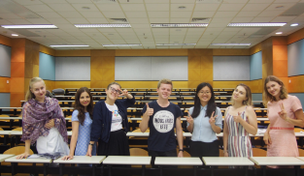
Incoming Students / Researchers
Visiting Research Students / Researchers Programme
Take specially designed courses / participating in research projects
Seek supports from different sources (Hong Kong government, Commission on Higher Education, World Bank, … etc)
Students from Russia
Scholars from Kazakhstan

Slide 14
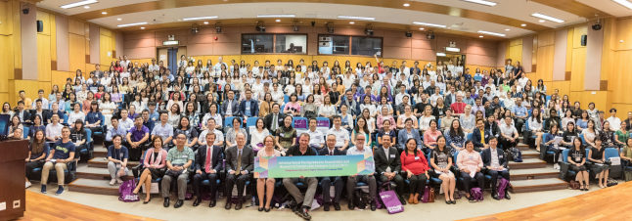
On-campus Internatioanlization
Annual International Postgraduate Summer School
started in 2012
hundreds of participants every year; e.g., >370 participants took part last time
Countries/Places where students came from:
Australia, China, Cambodia, France, Germany, Japan, Kazakhstan, Philippines, Russia, Sweden, Switzerland, Taiwan, ,Thailand, New Zealand, USA, Singapore, United Kingdom, Korea, Mongolia, Hong Kong, Macau, …

Slide 15
Research & Knowledge Transfer
Achievement in research is a strong factor for ranking, but sometimes being neglected within the domain of internationalization
Getting international grants is an important indicator but many institutions find it difficult
Joint research and publications: more straight forward but requires careful matching; start with a small group more realistic

Slide 16
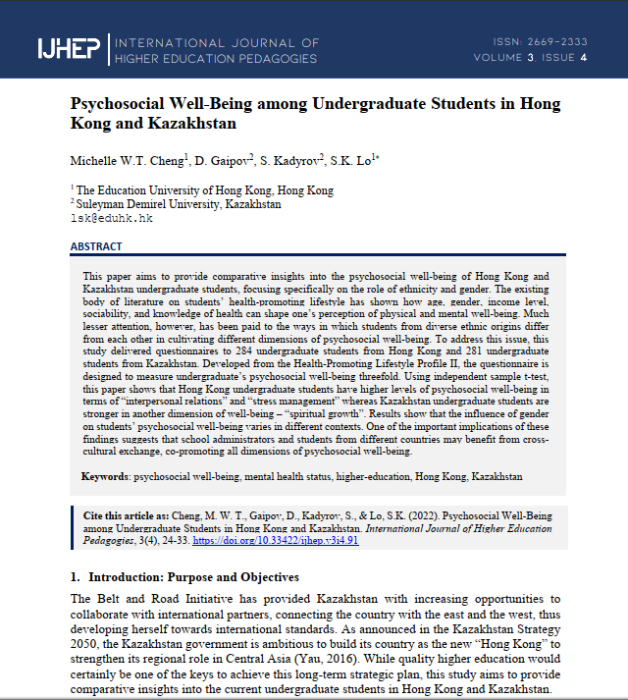
Joint Research / Publication
Psychosocial Well-Being among Undergraduate Students in Hong Kong and Kazakhstan
The Education University of Hong Kong
Suleyman Demirel University
Collaboration started in 2018

Slide 17
Networking: How ?
Many activities tend to be primarily social gathering
Networking to discuss, then proper follow-up (of everything listed in previous slides)
Enlarging the network through networking
Concept of balance: is it really necessary to have everything absolutely equal with each collaborator ?

Slide 18
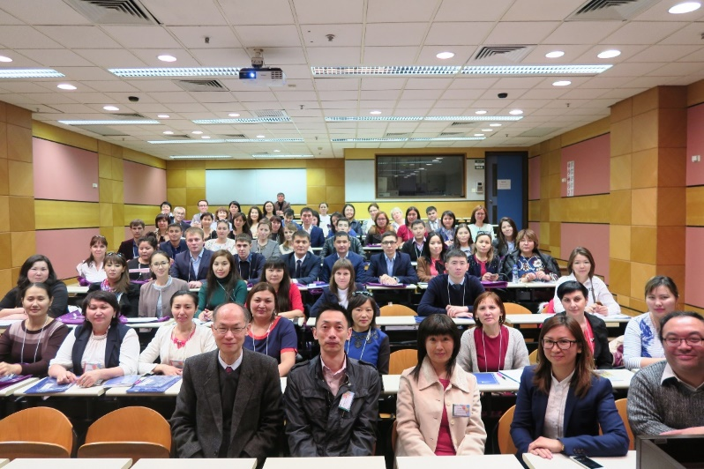
Inbound: Training Programs
For example, hosted a training workshop: Using English to Teach STEM Subjects
Initiated by Nazarbayev University
60 in-service teachers from different regions in Kzzakhstan came to EdUHK for one week

Slide 19
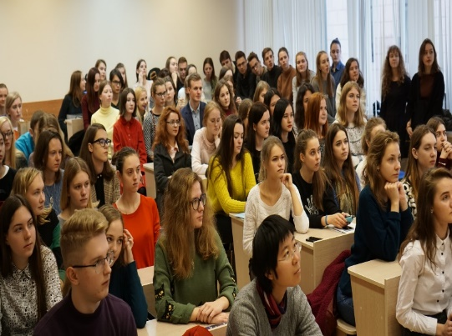
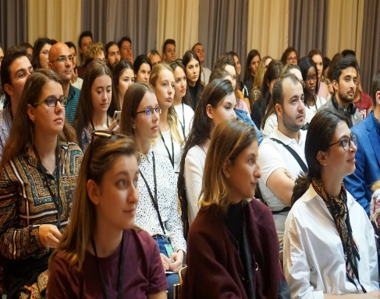
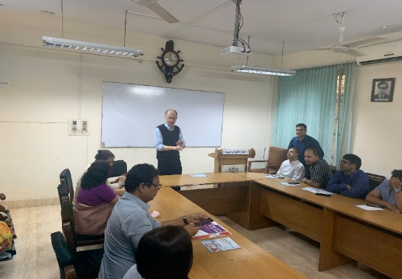
Outbound: Delivering of Training Workshops
combining and mixing lectures or workshops with promotional seminars was found to be more effective
Belarus
Romania
Cambodia

Slide 20
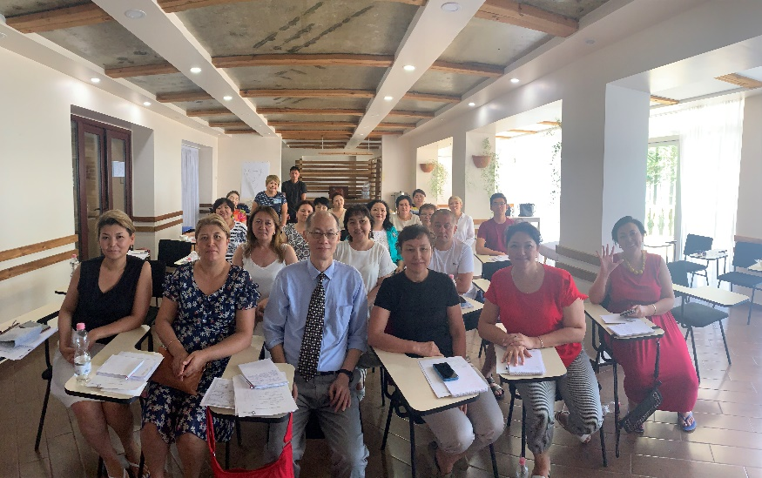
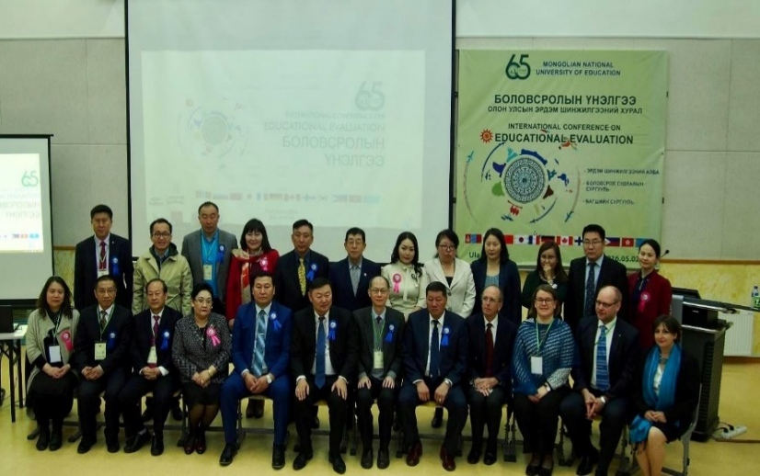
Outbound: Delivering of Training Workshops
Georgia
Mongolia
the Philippines

Slide 21
Online Training Programs
Capacity Building Programs
combining capacity building programs with promotional seminars was found to be effective

